Slide 1

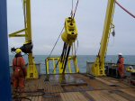
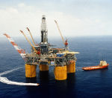
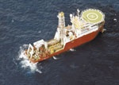
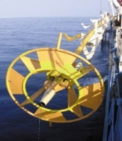
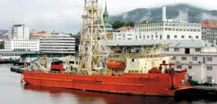
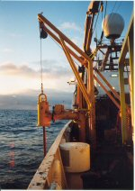

Sarathy Geotech & Engineering Services Pvt Ltd
(An ISO 9001:2008 and OHSAS 18001:2007 Certified)
Indian Concrete Institute (Bangalore Centre)
Innovative World of Concrete (ICI-IWC 2018)
International Conference on
INNOVATIONS IN CONCRETE
TO MEET HOUSING AND INFRACTURE CHALLENGES
®
CASE STUDY- DESIGN AND INSTALLATION OF DEEP FOUNDATION FOR HIGH RISE STRUCTURE
by
Dr CR Parthasarathy
Founder and Managing Director

Slide 2


Slide 3
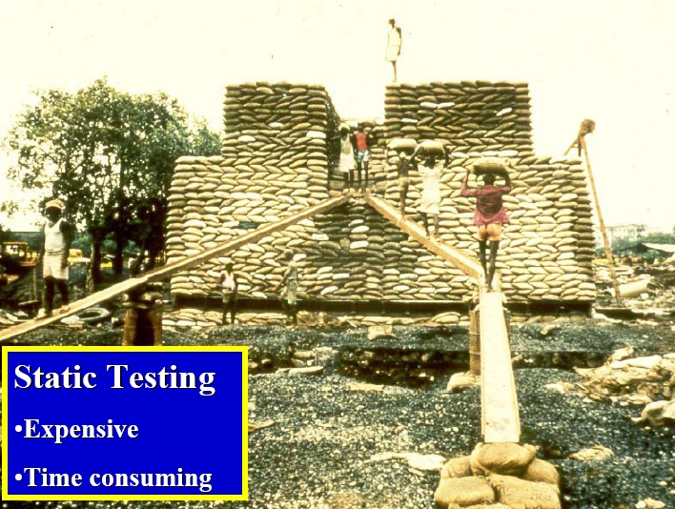
PILE CAPACITY BY STATIC LOAD TEST

Slide 4
PILE CAPACITY
Ref: US Department of Transportation
Publication No. FWHA NH-05-042,

Slide 5
DRIVEN PILES

Slide 7
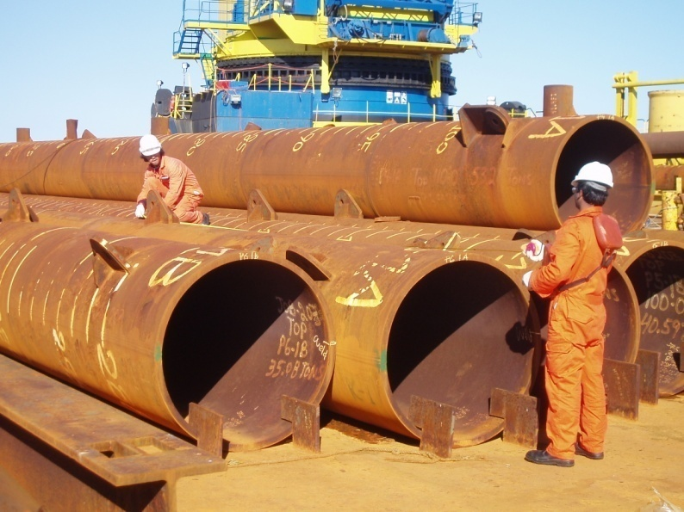
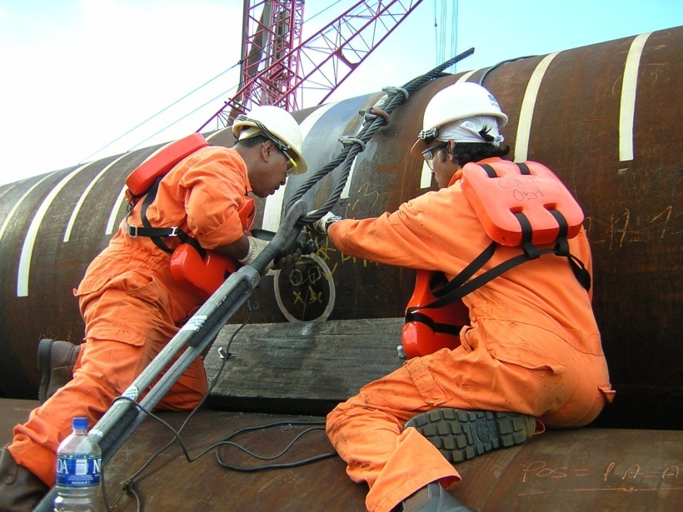
Tapping Instrumentation holes
Instrumentation when piles on barge

Slide 10
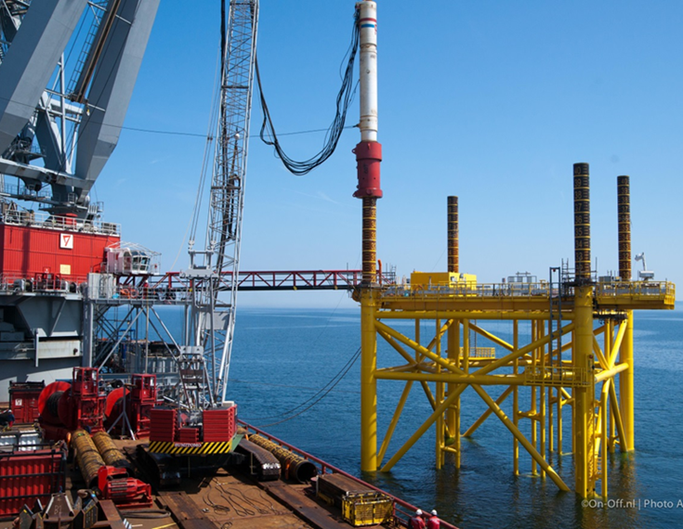

Slide 11
PILE CAPACITY BY DYNAMIC FORMULAE

Slide 12
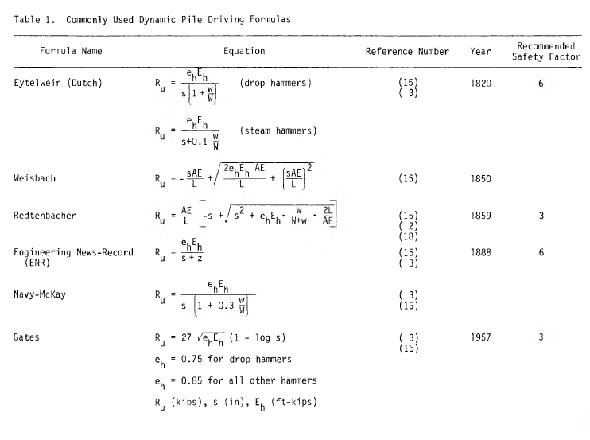
Richard J. Fragasy etal, 1985

Slide 13
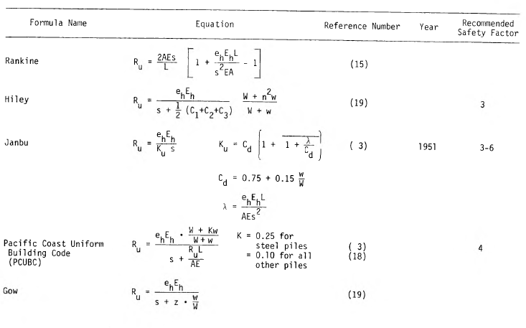
Richard J. Fragasy etal, 1985

Slide 14
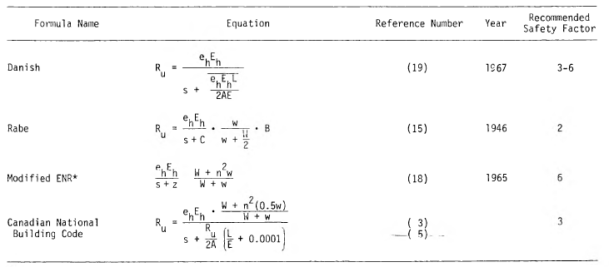
Richard J. Fragasy et al, 1985
Notes: Rabe’s formula is a combined dynamic and static formula.

Slide 15
Extract from Proc. ASCE conference, 1941

Slide 16
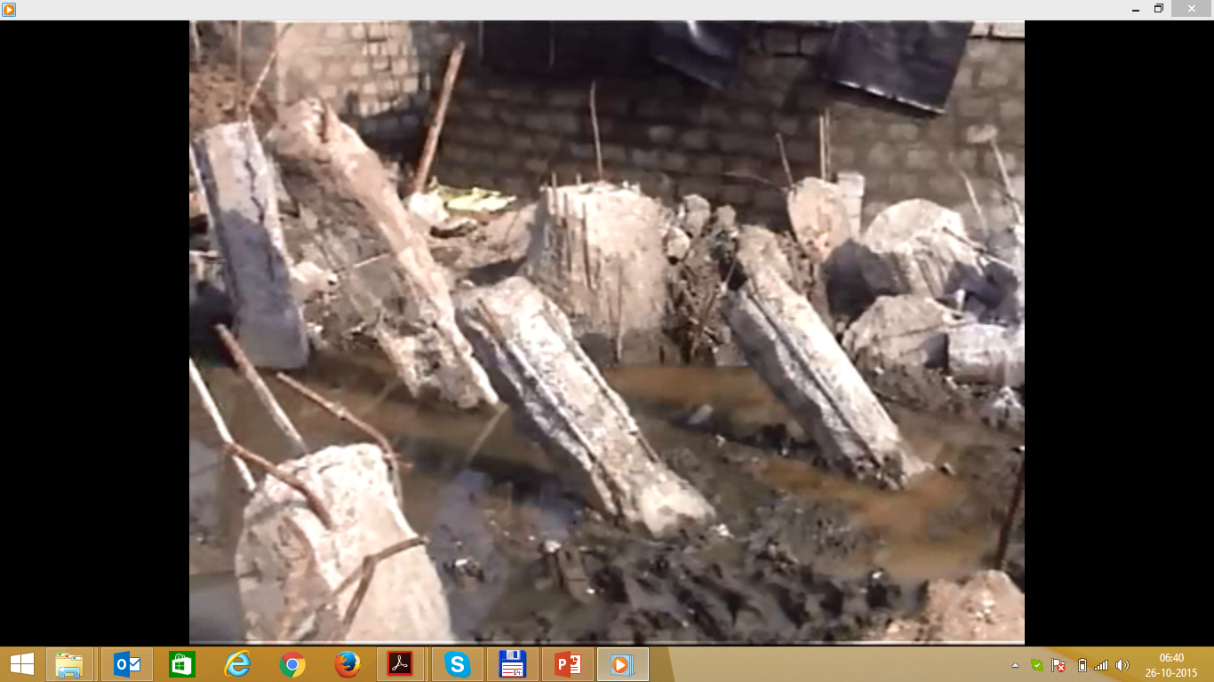

Slide 17
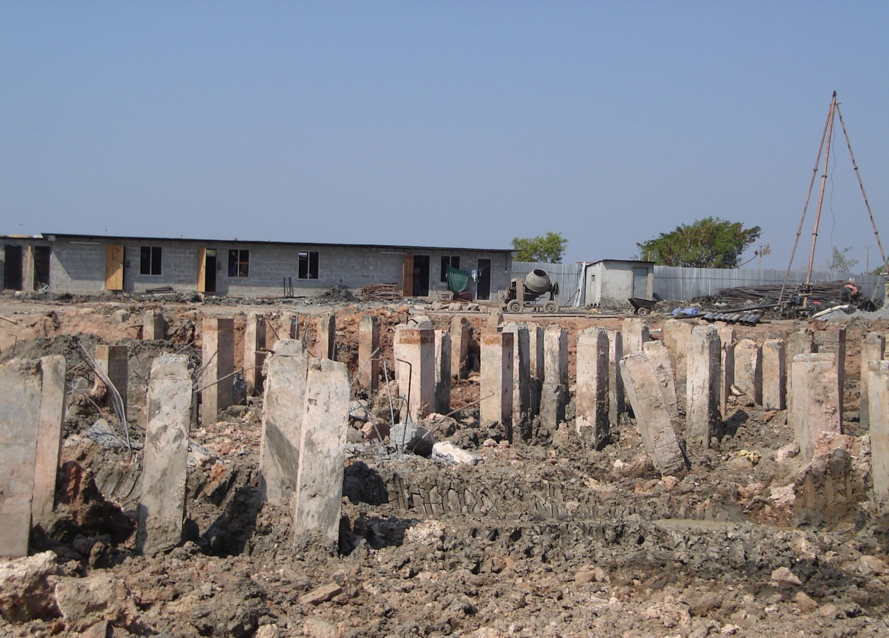

Slide 20
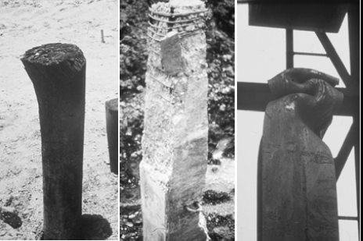
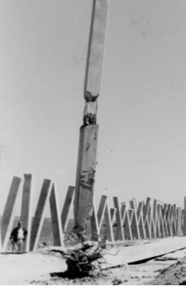
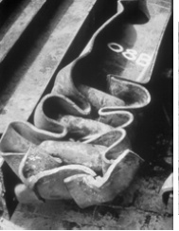
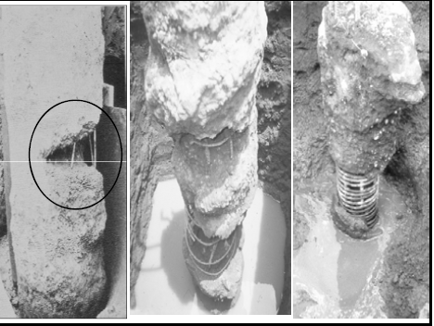
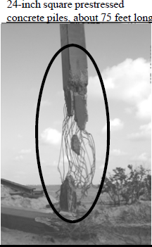
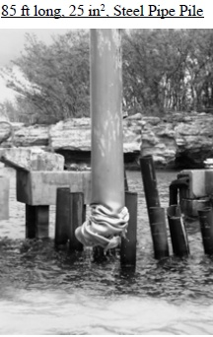

Slide 21

Today owners, engineers and contractors have a whole arsenal of modern technology and tools available to them to assist in providing efficient and economical deep foundation solutions

Slide 22
DYNAMIC PILE LOAD TEST
BACKGROUND
Research began at Case Institute of Technology (Cleveland) – 1964 under G. Goble
Developed Case Method – “PDA”
Pile Capacity From Pile Top Measurements
Wave Equation Analysis Program (WEAP)
CAPWAP (Case Pile Wave Analysis Program)

Slide 23
DYNAMIC TESTING
LOW STRAIN TEST
PILE INTEGRITY TESTER –PIT
[ASTM D5882]
HIGH STRAIN TEST
PILE DRIVING ANALYSER - PDA
[ASTM D4945]

Slide 24
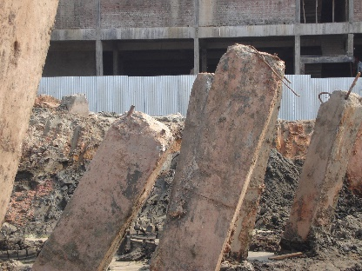
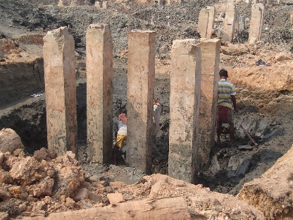
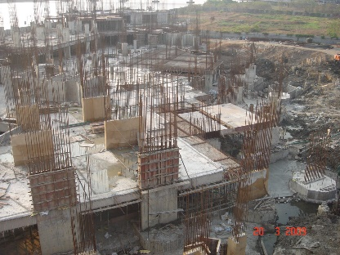
CASE STUDY - BACK GROUND

Slide 25
CONTENT
GENERAL PRESPECTIVE OF DRIVEN PILES
PILE CAPACITY BY DYNAMIC FORMULAE
DYNAMIC TESTING
FOUNDATION ASSESSMENT
DRIVEABILITY ASSESSMENT
REVIEW OF FOS BY DYNAMIC FORMULA
CAPACITY BY STATIC METHODS
SUMMARY OF STATIC PILE LOAD TEST RESULTS
NON LINEAR ANALYSIS OF PILES USING GROUP 2014 SOFTWARE
PLAXIS ANALYSIS
SUMMARY AND CONCLUSION

Slide 26
CASE STUDY

Slide 27
GENERAL PILE DESIGN GUIDELINES
Estimate the allowable pile capacity of single pile by static methods and geotechnical information. The factor of safety for static methods shall be 2.5. (Not done by contractor)
Based on the column loads (Service loads), determine number of piles required for the group. (Done by Contractor and thus arrived at various group configuration)
c. Estimate allowable lateral pile capacity - (Not done by Contractor)
d. Perform installation driveability/Wave Equation analysis – Not done by Contractor.
e. A pile group analysis shall be performed - either by elastic methods or numerical methods
for both service loads (unfactored) – verify deformations
ultimate loads (factored) – determine the structural reinforcement (Not done by Contractor)
f. Perform initial static vertical load test (2.5 times the allowable capacity) to confirm the estimated static capacity (Done by Contractor for one pile).

Slide 28
GENERAL PILE DESIGN GUIDELINES – contd..
g. Perform routine static vertical load test (1.5 times the allowable capacity) to confirm the estimated
static capacity (Done by Contractor for 5 nos of pile).
h. Perform initial static lateral load test (2.5 times the allowable capacity) to confirm the estimated
lateral capacity (Not Done by Contractor).
i. Perform routine static lateral load test (1.5 times the allowable capacity) to confirm the estimated
static capacity (Not done by Contractor).
j. Perform pile driving monitoring (NOT Done by Contractor).
k. Perform re-strike test to estimate long term capacity of driven piles and to ensure there is setup
(i.e. increase in capacity with time) and not relaxation (i.e. decrease in capacity with time) –
(Not done by Contractor)
l. Other criteria to satisfy structural requirement (viz., Buckling)- (Not considered by the contractor)
M. In the absence of pile driving monitoring, capacity estimation of driven piles is estimated using
Dynamic Formula – (Followed by Contractor).

Slide 29
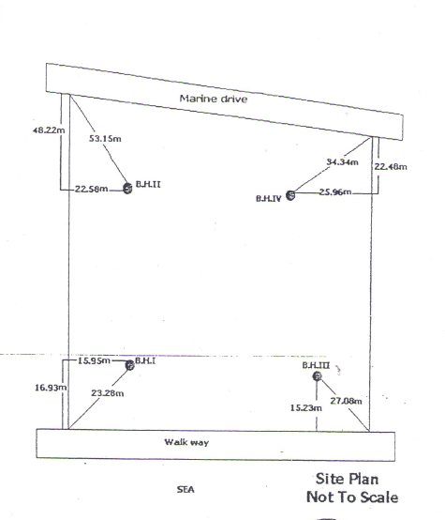
BOREHOLE POSITION

Slide 30
INTEGRATED INTENSIVE SITE INVESTIGATION FOR TALL STRUCTURES

Slide 31
INTEGRATED INTENSIVE ? SITE INVESTIGATION FOR TALL STRUCTURES

Slide 32
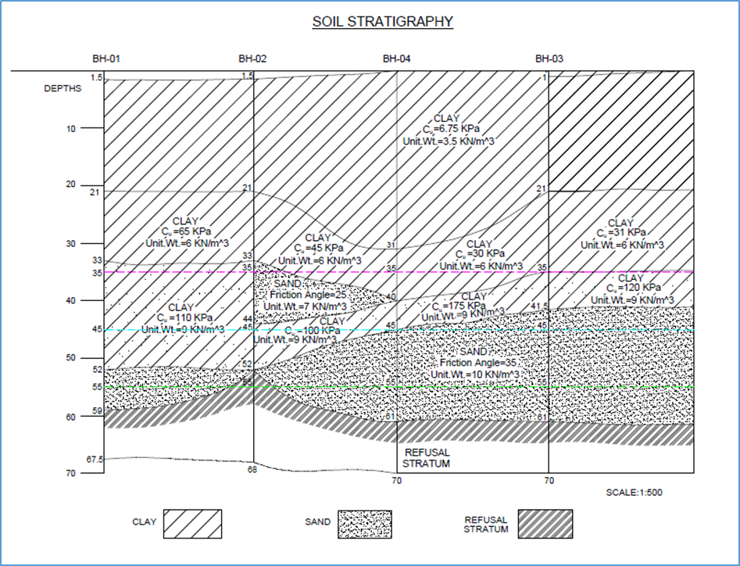
SOIL STRATIGRAPHY

Slide 33
BH - 1
Depth (m) | Delta Depth | N - Measured | Unit weight | Effective overburden pressure | correction factor | N Corrected
2 | 2 | 1 | 3.7 | 7.38 | 1.873389698 | 2
3 | 1 | 1 | 3.7 | 11.07 | 1.737799429 | 2
4 | 1 | 1 | 3.7 | 14.76 | 1.641596601 | 2
5 | 1 | 1 | 3.7 | 18.45 | 1.566975891 | 2
6 | 1 | 1 | 3.7 | 22.14 | 1.506006332 | 2
7.5 | 1.5 | 1 | 3.7 | 27.675 | 1.431385622 | 2
9 | 1.5 | 1 | 3.7 | 33.21 | 1.370416062 | 1
10.5 | 1.5 | 1 | 3.7 | 38.295 | 1.3227737 | 1
12 | 1.5 | 1 | 3.7 | 43.38 | 1.281080145 | 1
13.5 | 1.5 | 1 | 3.7 | 48.465 | 1.24401337 | 1
15 | 1.5 | 2 | 3.7 | 53.55 | 1.210648301 | 1
18 | 3 | 2 | 3.7 | 63.72 | 1.152500756 | 1
21 | 3 | 7 | 3.7 | 73.89 | 1.102982133 | 8
24 | 3 | 8 | 10.5 | 105.06 | 0.985286301 | 9
27 | 3 | 11 | 10.5 | 136.23 | 0.898403074 | 10
30 | 3 | 13 | 10.5 | 167.4 | 0.829501397 | 11
33 | 3 | 13 | 10.5 | 198.57 | 0.772399597 | 10
36 | 3 | 18 | 10.5 | 230.04 | 0.72320451 | 13
39 | 3 | 17 | 10.5 | 261.51 | 0.680327105 | 12
42 | 3 | 19 | 10.5 | 292.98 | 0.642327856 | 12
45 | 3 | 20 | 10.5 | 324.45 | 0.608209307 | 12
48 | 3 | 17 | 8.9 | 351.12 | 0.581792309 | 10
51 | 3 | 19 | 10.5 | 382.59 | 0.553088214 | 11
54 | 3 | 18 | 10.5 | 414.06 | 0.526654373 | 10
57 | 3 | 50 | 10.5 | 445.53 | 0.502157843 | 25
60 | 3 | 38 | 8.2 | 469.8 | 0.484420077 | 19

Slide 34
BH - 4
Depth (m) | Delta Depth | Observed N value | Unit weight | Effective overburden pressure | correction factor | N - Corrected
1 | 1 | 1 | 3.2 | 3.19 | 2.153874271 | 2
2 | 1 | 1 | 3.2 | 6.38 | 1.922081174 | 2
3 | 1 | 1 | 3.2 | 9.57 | 1.786490905 | 2
4 | 1 | 1 | 3.2 | 12.76 | 1.690288077 | 2
5 | 1 | 1 | 3.2 | 15.95 | 1.615667367 | 2
6 | 1 | 1 | 3.2 | 19.14 | 1.554697808 | 2
7.5 | 1.5 | 1 | 3.2 | 23.925 | 1.480077098 | 1
9 | 1.5 | 1 | 3.2 | 28.71 | 1.419107538 | 1
10.5 | 1.5 | 1 | 3.2 | 33.495 | 1.36755851 | 1
12 | 1.5 | 1 | 3.2 | 38.28 | 1.322904711 | 1
13.5 | 1.5 | 1 | 3.2 | 43.065 | 1.283517269 | 1
15 | 1.5 | 1 | 3.2 | 47.85 | 1.248284001 | 1
18 | 3 | 1 | 3.2 | 57.42 | 1.187314442 | 1
21 | 3 | 1 | 3.2 | 66.99 | 1.135765414 | 3
24 | 3 | 2 | 3.2 | 76.56 | 1.091111615 | 2
27 | 3 | 2 | 5.8 | 93.93 | 1.022733768 | 2
30 | 3 | 3 | 5.8 | 111.3 | 0.96599182 | 3
33 | 3 | 4 | 5.8 | 128.67 | 0.917495575 | 4
36 | 3 | 4 | 5.8 | 146.04 | 0.875149792 | 4
39 | 3 | 6 | 5.8 | 163.41 | 0.837568552 | 5
42 | 3 | 27 | 10.1 | 193.68 | 0.780737819 | 21
45 | 3 | 100 | 10.1 | 223.95 | 0.732176775 | 73
48 | 3 | 37 | 10.1 | 254.22 | 0.689781617 | 26
51 | 3 | 50 | 10.1 | 284.49 | 0.652161503 | 33
54 | 3 | 50 | 10.1 | 314.76 | 0.618348853 | 31
57 | 3 | 50 | 10.1 | 345.03 | 0.587643316 | 29
64 | 7 | 50 | 10.1 | 415.66 | 0.525364657 | 26

Slide 35
CAPACITY OF PILES BY LINEAR EXTRAPOLATION
(As per the Geotechnical report)
Dia (cm) | Pile capacity (MT) | Remarks
45 (400mm x 400mm) | 60 | Linearly interpolated
50 | 74 | As provided in the Geotech report
60 | 106
70 | 144
90 | 240 | Linearly interpolated

Slide 36
IS - Method
Ultimate Pile Capacity – MT - (900mm Dia)
240T x 2.5 = 600T
Penetration, m
Initial assumed penetration of 55m is in order

Slide 37
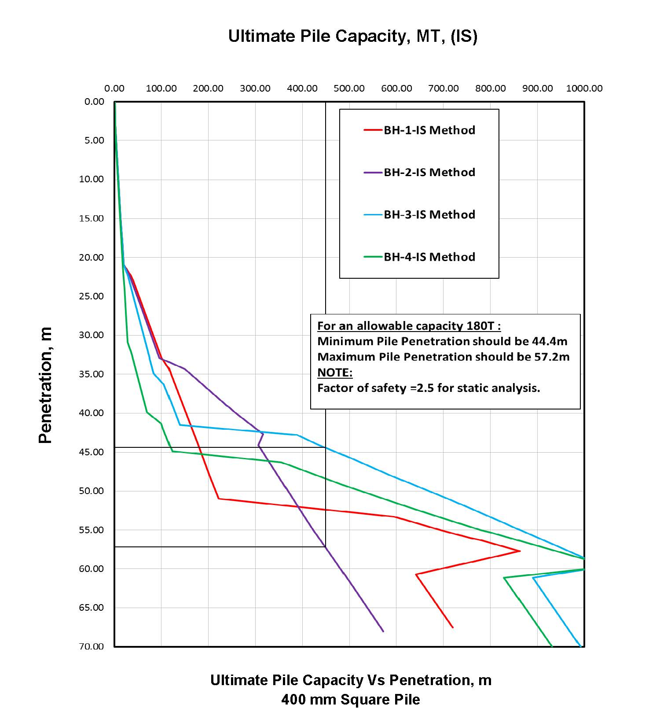

Slide 38
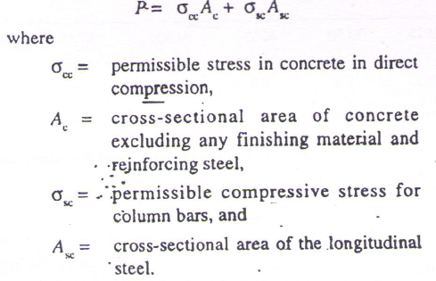
STRUCTURAL CAPACITY
As per IS 456:2000, Structural capacity is calculated as:
For 4 nos. of 25mm diameter bars, the computed structural capacity is 180 T.
The allowable capacity specified by CONTRACTOR is same as the structural capacity, which is 3 times the geotechnical capacity

Slide 39
Number of Piles terminated at Various Penetrations
Type | Penetration (m) | No. of Piles | Remarks
PRECAST PILE | < 35 m | 44
 | 35m - 45m | 431 | Most of the Piles terminated at 40 to 44m
 | 45m - 55m | 59
 | >55m | 13

Slide 40
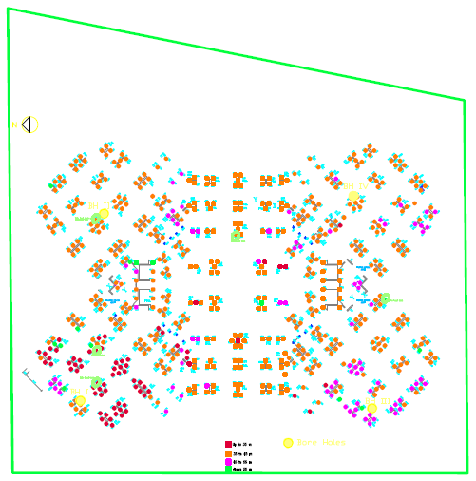
PILE POSITIONS
UPTO 35 M
35 TO 45 M
45 TO 55 M
ABOVE 55 M

Slide 41
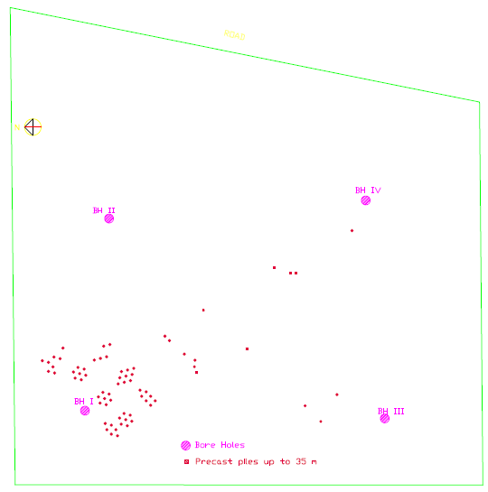
PILE POSITIONS
PRECAST PILES UPTO 35 M
BOREHOLES

Slide 42
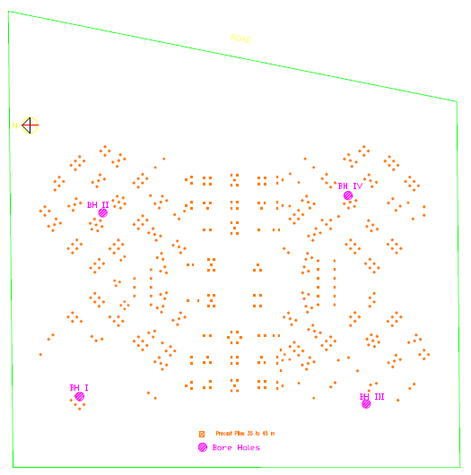
PRECAST PILES UPTO 35 TO 45 M
BOREHOLES

Slide 43
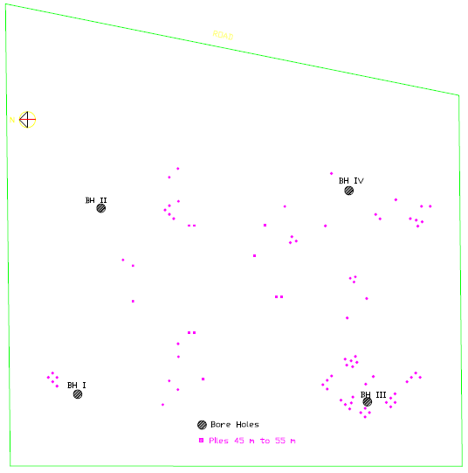
PILE POSITIONS
PRECAST PILES UPTO 45 TO 55 M
BOREHOLES

Slide 44
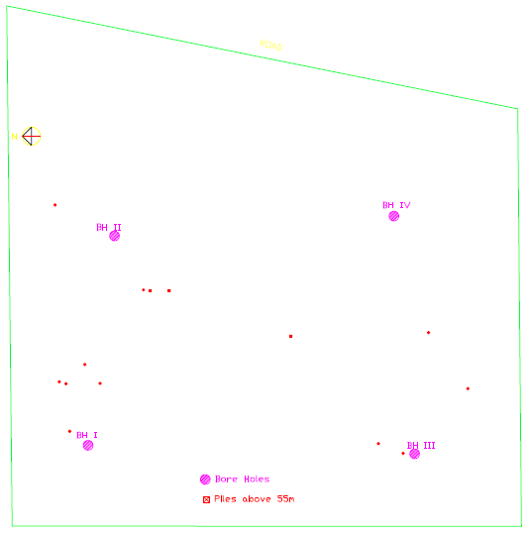
PILE POSITIONS
PRECAST PILES ABOVE 55 M
BOREHOLES

Slide 47
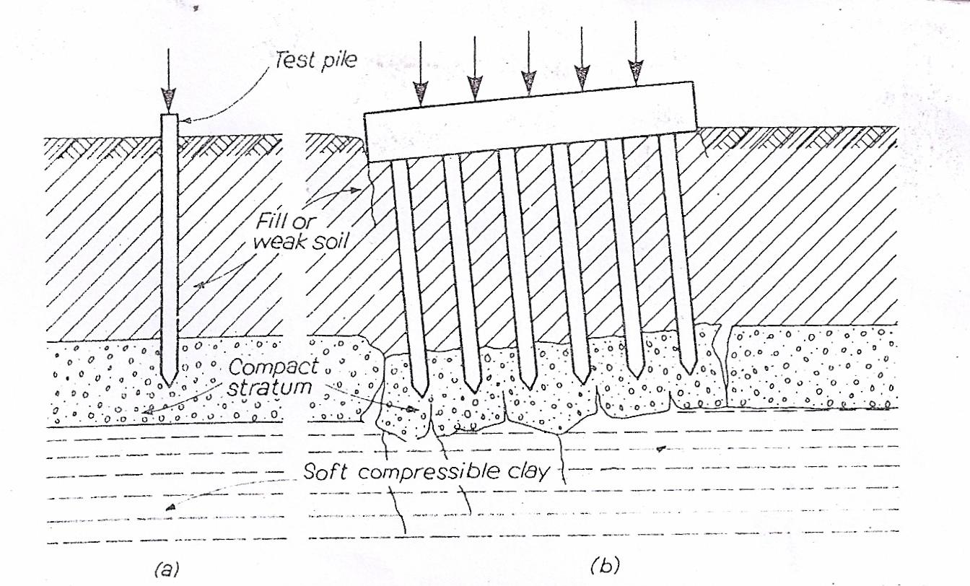
CHARITY HOSPITAL AT NEW ORLEANS
TERZAGHI AND PECK ( 1967 )
Deeper Depth of Investigation

Slide 48
P 4A Column
Pile No: 648 - 39.7 m BH-4
Pile No: 649 -54.9 m At 45 m Sand layer is present, terminated the piles at 39.7m
Pile No: 650 -45.2 m
Pile No: 651 -44.7 m
P 5A Column BH-1
Pile No: 236 – 32.1 m At 52 m Sand layer is present, terminated the piles at 32.1m
Pile No: 237 – 65.1 m Soil Test.pdf
Pile No: 238 -76.7m
Pile No: 239 -40.2 m
Pile No: 240 -42.4 m

Slide 52
SUMMARY OF STATIC PILE LOAD TEST RESULTS

Slide 53
Measured gross settlement v/s Elastic settlement (Tests performed by Other Agencies)
Pile No | Agency | Project | Dia (mm) | Length of pile (m) | MGS* (mm) | EC** (mm) | REMARKS
P-116 | I | This Project | 400 (Circular) | 12 | 10.51 | 1.43 | GROSS SETTLEMENT IS GREATER THAN ELASTIC COMPRESSION OK
P-77 | II | This Project | 900 (Circular) | 54 | 2.27 | 2.13
P-121 |  | This Project | 900 (Circular) | 55 | 6.41 | 1.41
P-190 |  | This Project | 900 (Circular) | 55 | 4.02 | 1.41
P-345 |  | This Project | 400 (Square) | 43 | 15.87 | 8.03
- | III | Adjacent project | 750 (Circular) | 26.25 | 12.87 | 7.92
- |  | Adjacent project | 900 (Circular) | 23.28 | 19.80 | 4.56
*MGS – Measured Gross Settlement, ** EC - Elastic Settlement computed For all the piles, measured gross settlement is MORE than elastic settlement

Slide 55
SUMMARY OF LOAD TEST RESULTS PERFORMED BY THE CONTRACTOR
Pile No | Agency | Project | Dia (mm) | Length of pile (m) | MGS* (mm) | EC** (mm) | REMARKS
P 213 | CONTRACTOR | HIGH RISE | 400 | 32.28 | 3.49 | 16.41 | GROSS SETTLEMENT IS LESSER THAN ELASTIC COMPRESSION NOT OK
P-619 |  |  |  | 55 | 4.07 | 12.94
P-230 |  |  |  | 32.7 | 4.45 | 16.46
P-255
 |  |  |  | 32.1 | 3.575 | 16.35
P-463 |  |  |  | 44.66 | 4.26 | 16.89
TP1 |  |  |  | 45.3 | 5.88 | 31
*MGS – Measured Gross Settlement, ** EC - Elastic Settlement are computed
For all the piles, measured gross settlement is LESS than elastic settlement??

Slide 56
SUMMARY OF LOAD TEST RESULTS AT SEVERAL OTHER PROJECTS OF CONTRACTOR

Slide 57
SUMMARY OF LOAD TEST RESULTS AT SEVERAL OTHER PROJECTS CONTRACTOR
The load test rests are unreliable and questionable
The allowable load is not established as per IS 2911 (Part 4) - 1985

Slide 58
DRIVEABILITY STUDY

Slide 59
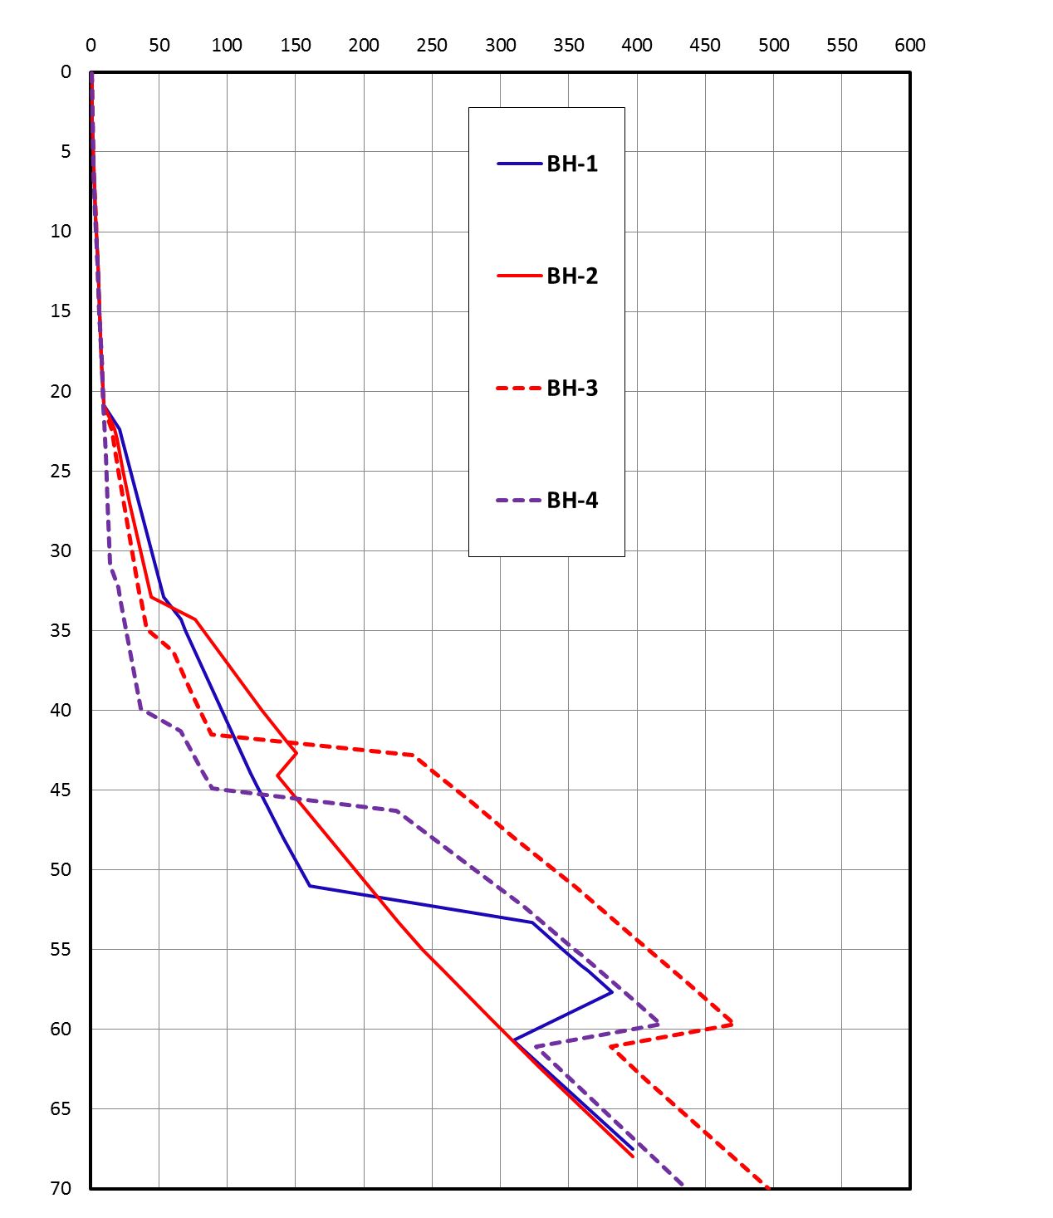
Penetration (m)
SOIL RESISTANCE TO DRIVING, SRD – (Tonnes)
400 mm Square precast concrete Pile
Assumed 50% reduction of strength in CLAY and no reduction for SANDS.

Slide 60
Penetration (m)
Blows/0.25m
5 TONS Drop Weight,
1m height of fall
(50 kN-m rated energy)
Assumed Energy for analysis
(45KN-m - ie 90% HE)
400 mm Square precast concrete Pile
Efficiency-90%

Slide 61
Penetration (m)
Compressive Stresses (MPa)
5 TONS Drop Weight,
1m height of fall
(50 kN-m rated energy)
Assumed Energy for analysis
(45KN-m - ie 90% HE)
400 mm Square precast concrete Pile
Efficiency-90%
Allowable Compressive Stress
0.85 x fck
0.85 x 35MPa = 29.75 MPa

Slide 62
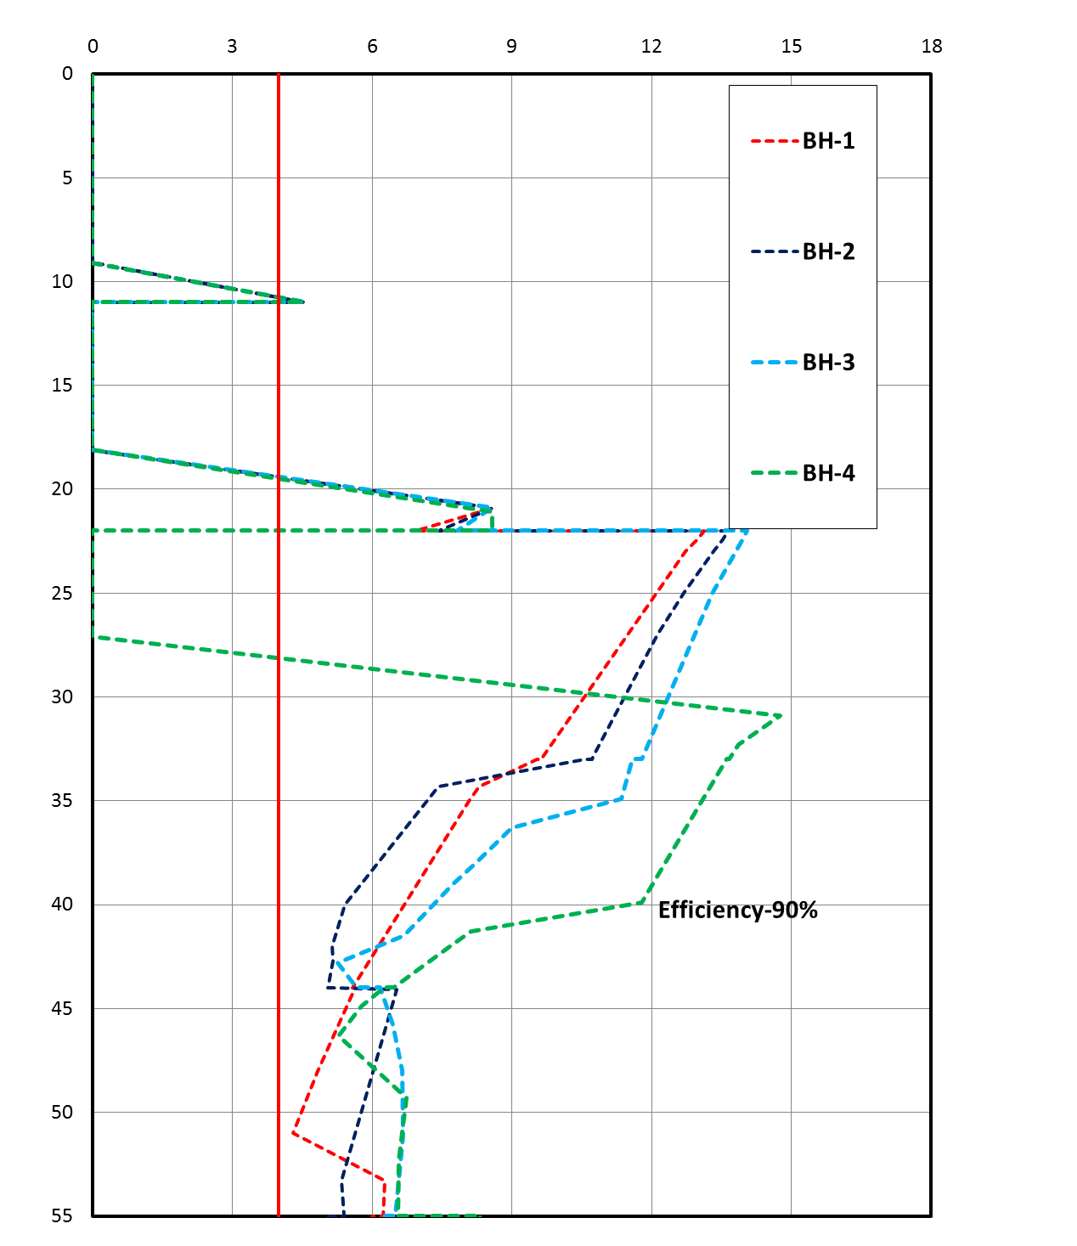
Penetration (m)
Tensile Stress (MPa)
Allowable Tensile Stress
0.7x fy (As/Ac)
= 4 MPa
5 TONS Drop Weight,
1m height of fall
(50 kN-m rated energy)
Assumed Energy for analysis
(45KN-m - ie 90% HE)
400 mm Square precast concrete Pile

Slide 63
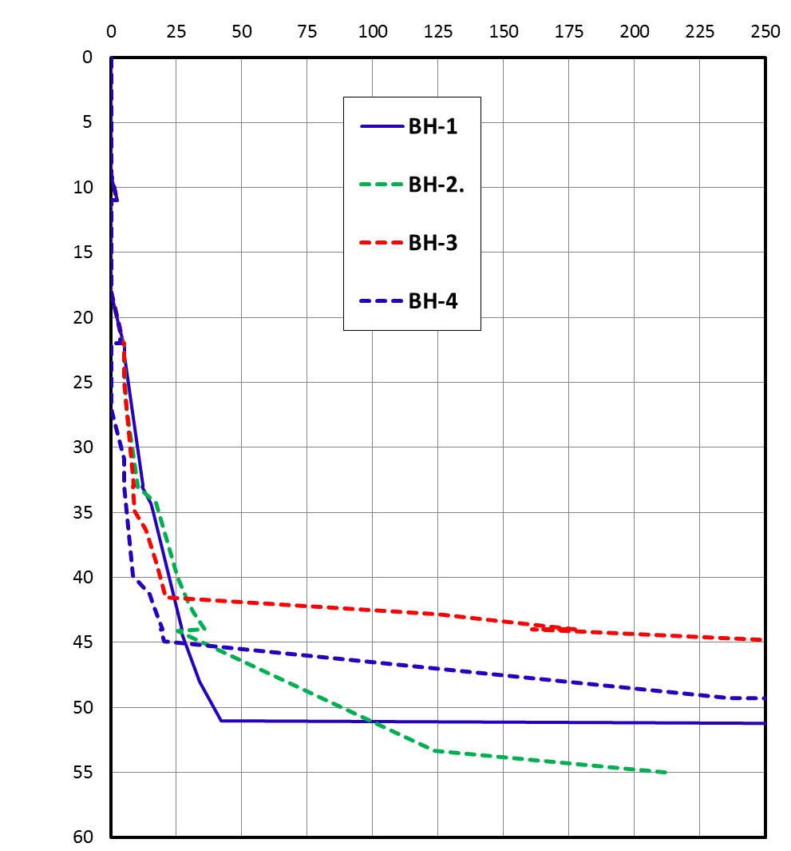
Blows/0.25m
Penetration (m)
400 mm Square precast concrete Pile
45% EFFICIENCY

Slide 64
Penetration (m)
Compressive Stresses (MPa)
5 TONS Drop Weight,
1m height of fall
(50 kN-m rated energy)
400 mm Square precast concrete Pile
Allowable Compressive Stress
0.85 x fck
0.85 x 35MPa = 29.75 MPa

Slide 65
Penetration (m)
Tensile Stress (MPa)
Allowable Tensile Stress
0.7x fy (As/Ac)
= 4 MPa
5 TONS Drop Weight,
1m height of fall
(50 kN-m rated energy)
400 mm Square precast concrete Pile

Slide 66
Penetration (m)
Blows/0.25m
5 TONS Drop Weight,
1m height of fall
(50 kN-m rated energy)
400 mm Square precast concrete Pile
BH-2 is the weakest borehole.

Slide 67
Penetration, m
Blows/0.25m
Blow counts Vs Penetration
BH-2
Efficiency varies from 20 to 50%
Average Blow counts for Pile Locations 339 to 345

Slide 68
Established range of hammer efficiencies by back analysis
BH-1 | BH-2 | BH-3 | BH-4
Pile 201 | Pile 339 | Pile 557 | Pile 709
Pile 202 | Pile 340 | Pile 558 | Pile 710
Pile 203 | Pile 341 | Pile 560 | Pile 711
Pile 204 | Pile 342 | - | Pile 712
Pile 205 | Pile 343 | - | Pile 713
Pile 206 | Pile 344 | - | Pile 714
- | Pile 345 | - | Pile 715
Established range of hammer efficiencies by back analysis
20 to 30% HE | 20 to 50% HE | 20 to 45% HE | About 10% HE

Slide 69
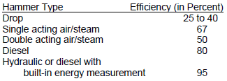
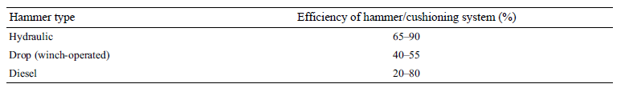
PILE DRIVING CONTRACTORS ASSOCIATION
“PILE DESIGN AND CONSTRUCTION PRACTICES”- M.J.TOMILSON

Slide 70
FACTOR OF SAFETY BY DYNAMIC FORMULA

Slide 71
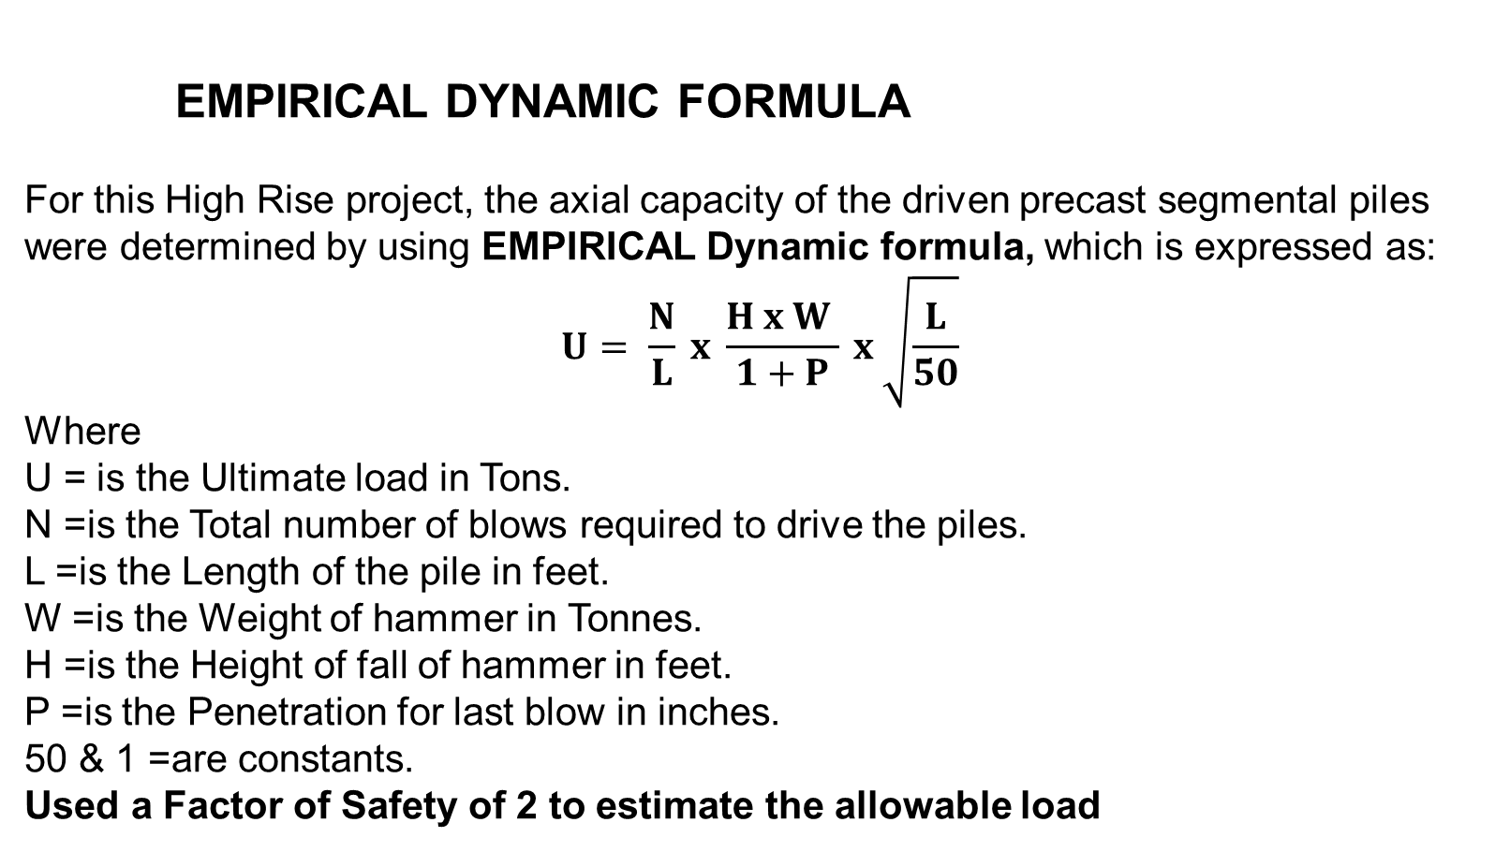
    empirical DYNAMIC FORMULA
For this High Rise project, the axial capacity of the driven precast segmental piles were determined by using EMPIRICAL Dynamic formula, which is expressed as:
$$U= \frac{N}{L} x \frac{H x W }{1+P} x \sqrt{\frac{L}{50}}$$
Where
U = is the Ultimate load in Tons.
N =is the Total number of blows required to drive the piles.
L =is the Length of the pile in feet.
W =is the Weight of hammer in Tonnes.
H =is the Height of fall of hammer in feet.
P =is the Penetration for last blow in inches.
50 & 1 =are constants.
Used a Factor of Safety of 2 to estimate the allowable load

Slide 72
Summary of ultimate pile capacity of all the piles using EMPIRICAL Dynamic formula
Factor of safety | < 2 | 2 – 2.5 | 2.5 - 3 | > 3
No: of piles | 31 | 117 | 265 | 133
Percentage | 5% | 18.50% | 42.06% | 21.10%
(80% efficiency)
Factor of safety | < 2 | 2 – 2.5 | 2.5 - 3 | > 3
No: of piles | 145 | 306 | 87 | 8
Percentage | 23.10% | 48.57% | 13.81% | 1.27%
(60% efficiency)
Factor of safety | < 2 | 2 – 2.5 | 2.5 - 3 | > 3
No: of piles | 504 | 37 | 2 | 3
Percentage | 80% | 5.87% | 0.32% | 0.48%
(100% efficiency)

Slide 73
CAPACITY BY STATIC METHODS

Slide 74
Pile capacity as per IS Method for 400mm square piles
BORE HOLE NO. | ULTIMATE PILE CAPACITY (MT) |  |  |  | Allowable load (MT) | Factor of safety
 | 35 m | 42 m | 45 m | 55 m |  | 35 m | 42 m | 45 m | 55 m
1 | 120 | 165 | 185 | 698 | 180 | 0.67 | 0.92 | 1.03 | 3.88
2 | 165 | 302 | 314 | 422 | 180 | 0.92 | 1.68 | 1.74 | 2.34
3 | 83 | 225 | 470 | 860 | 180 | 0.46 | 1.25 | 2.61 | 4.78
4 | 49 | 105 | 128 | 775 | 180 | 0.27 | 0.58 | 0.71 | 4.31
BORE HOLE NO. | ULTIMATE PILE CAPACITY (MT) |  |  |  | FOS | Allowable Pile capacity(MT)
 | 35 m | 42 m | 45 m | 55 m |  | 35 m | 42 m | 45 m | 55 m
1 | 120 | 165 | 185 | 698 | 2.5 | 48.00 | 66.00 | 74.00 | 279.20
2 | 165 | 302 | 314 | 422 | 2.5 | 66.00 | 120.80 | 125.60 | 168.80
3 | 83 | 225 | 470 | 860 | 2.5 | 33.20 | 90.00 | 188.00 | 344.00
4 | 49 | 105 | 128 | 775 | 2.5 | 19.60 | 42.00 | 51.20 | 310.00
Average Ultimate Capacity(MT) | 104.25 | 199.25 | 274.25 | 688.75 | Average Allowable Capacity Load (MT) | 41.70 | 79.70 | 109.70 | 275.50

Slide 75
NON LINEAR ANALYSIS USING GROUP 2014 SOFTWARE

Slide 76
900 mm Diameter

Slide 77
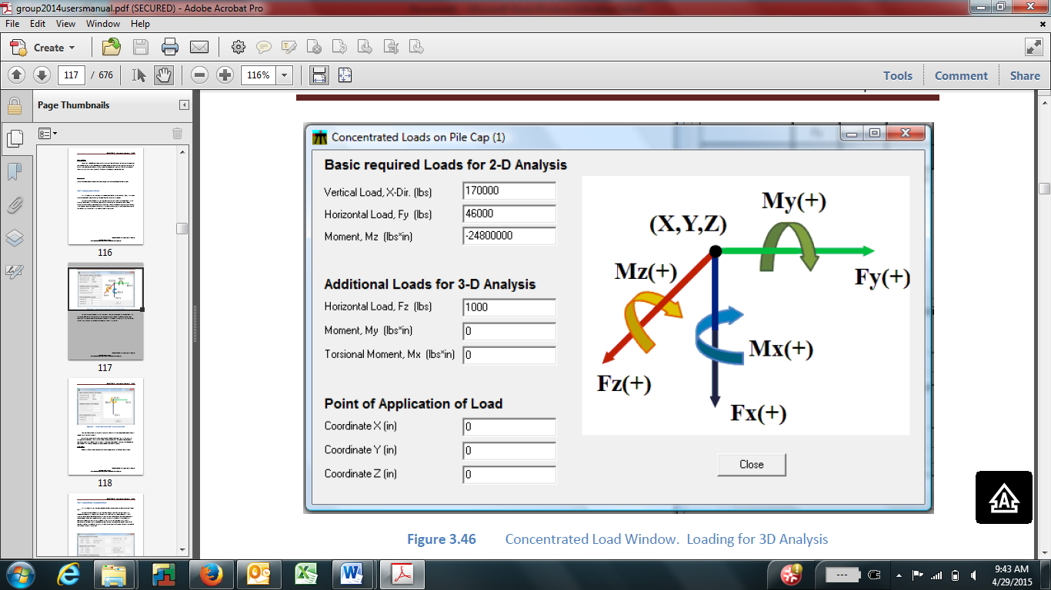
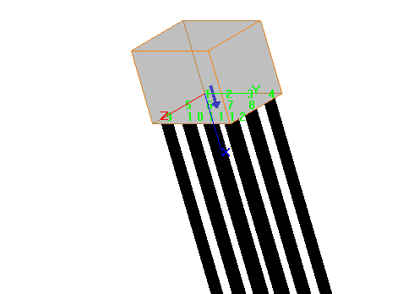
The fixed coordinate system for the pile soil analysis in GROUP 2014
Note: All the loads were applied at the C.G of the pile cap

Slide 78
Group response of un-factored loads without Lateral Load
Dia | Depth | load | No of Piles |  | Max Pile top Displacement BH-01 |  |  |  |  | Max Pile top Displacement BH-02 |  |  |  | Max Pile top Displacement BH-03 |  |  |  | Max Pile top Displacement BH-04
(mm) | (m) | (kN) |  |  | X(mm) |  | Y(mm) |  | Z(mm) | X(mm) | Y(mm) |  | Z(mm) | X(mm) |  | Y(mm) | Z(mm) | X(mm) |  | Y(mm) |  | Z(mm)
900 | 55 | 6350 | 3 |  | 4.300 |  | 0.000 |  | 0.000 | 4.840 | 0.000 |  | 0.000 | 5.300 |  | 0.000 | 0.000 | 6.300 |  | 0.000 |  | 0.000
 |  | 20000 | 9 |  | 4.630 |  | 0.000 |  | 0.000 | 5.110 | 0.000 |  | 0.000 | 5.670 |  | 0.000 | 0.000 | 6.370 |  | 0.000 |  | 0.000
Group response of factored loads without Lateral Load
Dia | Depth | load | No of Piles | Pile top Reaction BH-01 |  |  |  |  |  | Pile top Reaction BH-02 |  |  |  |  | Pile top Reaction BH-03 |  |  |  | Pile top Reaction BH-04
(mm) | (m) | (kN) |  | P_{u}(kN) |  | V_{u}(kN) |  | M_{u}(kN-m) |  | P_{u}(kN) | V_{u}(kN) | M_{u}(kN-m) |  |  | P_{u}(kN) | V_{u}(kN) | M_{u}(kN-m) |  | P_{u}(kN) | V_{u}(kN) | M_{u}(kN-m)
900 | 55 | 9525 | 3 | 3175.0 |  | 0.000 |  | 5.1 |  | 3175.0 | 0.000 | 5.490 |  |  | 3175.0 | 0.000 | 5.370 |  | 3175.0 | 0.000 | 9.180
 |  | 30000 | 9 | 3333.3 |  | 0.000 |  | 0.000 |  | 3333.3 | 0.000 | 0.000 |  |  | 3333.3 | 0.000 | 0.000 |  | 3333.3 | 0.000 | 0.000

Slide 79
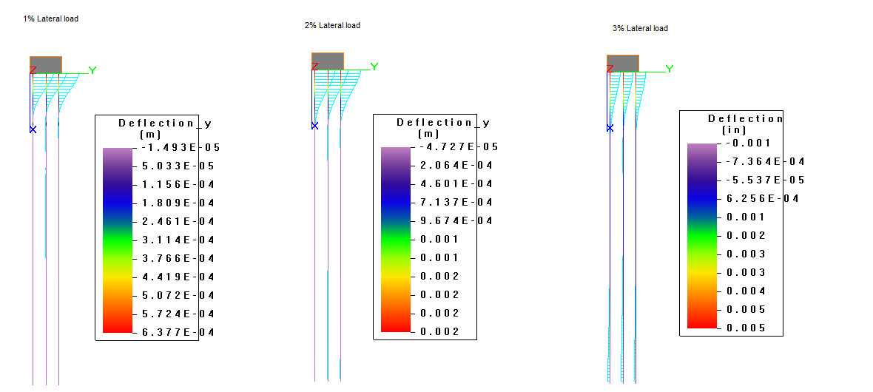
Response of group action of 900mm dia bored pile, 55m long with lateral loads

Slide 80
2% of 2000 T = 40T for the group of 9 piles, Therefore 4.4T per pile, which is 1.8% of the allowable load of 240 T
Unfactored with 2% Lateral Load (40T)
Dia | Depth | load | No of Piles | Max Pile top Displacement BH-01 |  |  | Max Pile top Displacement BH-02 |  |  |  | Max Pile top Displacement BH-03 |  |  |  |  | Max Pile top Displacement BH-04
(mm) | (m) | (kN) |  | X(mm) | Y(mm) | Z(mm) | X(mm) | Y(mm) |  | Z(mm) | X(mm) |  | Y(mm) |  | Z(mm) | X(mm) | Y(mm) |  | Z(mm)
900 | 55 | 20000 | 9 | 4.870 | 2.490 | 0.000 | 5.020 | 2.480 |  | 0.000 | 5.900 |  | 2.560 |  | 0.000 | 6.640 | 2.580 |  | 0.000
Factored with 2% Lateral Load (40T)
Dia | Depth | load | No of Piles | Pile top Reaction BH-01 |  |  | Pile top Reaction BH-02 |  |  |  |  | Pile top Reaction BH-03 |  |  |  | Pile top Reaction BH-04
(mm) | (m) | (kN) |  | P_{u}(kN) | V_{u}(kN) | M_{u}(kN-m) | P_{u}(kN) | V_{u}(kN) | M_{u}(kN-m) |  |  | P_{u}(kN) | V_{u}(kN) | M_{u}(kN-m) |  | P_{u}(kN) | V_{u}(kN) | M_{u}(kN-m)
900 | 55 | 30000 | 9 | 3418.0 | 43.1 | 127.0 | 3417.0 | 43.1 | 127.0 |  |  | 3487.0 | 43.1 | 127.0 |  | 3415.0 | 43.3 | 124.0
The reinforcement provided is adequate

Slide 81
400 mm Square Piles

Slide 82
Without lateral load
Group response of un-factored without Lateral Load
Diam | Depth |  | load | No of Piles |  | Pile top Displacement BH-01 |  |  |  | Pile top Displacement BH-02 |  |  |  | Pile top Displacement BH-03 |  |  |  | Pile top Displacement BH-04
(mm) | (m) |  | (kN) |  |  | X(mm) | Y(mm) |  | Z(mm) | X(mm) | Y(mm) |  | Z(mm) | X(mm) | Y(mm) |  | Z(mm) | X(mm) | Y(mm) |  | Z(mm)
451.35 (0.4m square) | 55 |  | 6350 | 4 |  | 9.81 | 0.00 |  | 0.00 | 10.62 | 0.00 |  | 0.00 | 10.85 | 0.00 |  | 0.00 | 11.91 | 0.00 |  | 0.00
 |  |  | 20000 | 12 |  | 10.37 | 0.00 |  | 0.00 | 11.13 | 0.00 |  | 0.00 | 11.53 | 0.00 |  | 0.00 | 12.70 | 0.00 |  | 0.00
 | 45 |  | 6350 | 4 |  | 10.04 | 0.00 |  | 0.00 | 10.90 | 0.00 |  | 0.00 | 10.90 | 0.00 |  | 0.00 | 12.20 | 0.00 |  | 0.00
 |  |  | 20000 | 12 |  | 10.78 | 0.00 |  | 0.00 | 11.70 | 0.00 |  | 0.00 | 11.71 | 0.00 |  | 0.00 | 13.00 | 0.00 |  | 0.00
 | 35 |  | 6350 | 4 |  | Bearing Failure
 |  |  | 20000 | 12
Group response of factored without Lateral Load
Diam |  | Depth | load | No of Piles | Pile top Reaction BH-01 |  |  |  |  | Pile top Reaction BH-02 |  |  |  | Pile top Reaction BH-03 |  |  |  | Pile top Reaction BH-04
(mm) |  | (m) | (kN) |  | P_{u}(kN) |  | V_{u}(kN) | M_{u}(kN-m) |  | P_{u}(kN) | V_{u}(kN) | M_{u}(kN-m) |  | P_{u}(kN) | V_{u}(kN) | M_{u}(kN-m) |  | P_{u}(kN) | V_{u}(kN) | M_{u}(kN-m)
451.35 (0.4m square) |  | 55 | 9525 | 4 | 2381.70 |  | 0.00 | 0.27 |  | 2381.00 | 0.00 | 0.26 |  | 2381.70 | 0.00 | 0.28 |  | 2381.70 | 0.00 | 0.28
 |  |  | 30000 | 12 | 2500.00 |  | 0.00 | 0.00 |  | 2500.00 | 0.00 | 0.00 |  | 2500.00 | 0.00 | 0.00 |  | 2500.00 | 0.00 | 0.00
 |  | 45 | 9525 | 4 | 2381.40 |  | 0.00 | 0.39 |  | 2381.00 | 0.00 | 0.00 |  | 2381.00 | 0.00 | 0.33 |  | 2381.00 | 0.00 | 0.35
 |  |  | 30000 | 12 | Bearing Failure |  |  |  |  |  |  |  |  | 2500.00 | 0.00 | 0.00 |  | 2500.00 | 0.00 | 0.00
 |  | 35 | 9525 | 4 | Bearing Failure
 |  |  | 30000 | 12

Slide 83
With lateral load
Group response un-factored with Lateral Load (1.8% of 180 ton (3.2T)
Diameter | Depth | load | No of Piles | Pile top Displacement BH-01 |  |  | Pile top Displacement BH-02 |  |  | Pile top Displacement BH-03 |  |  | Pile top Displacement BH-04
(mm) | (m) | (kN) |  | X(mm) | Y(mm) | Z(mm) | X(mm) | Y(mm) | Z(mm) | X(mm) | Y(mm) | Z(mm) | X(mm) | Y(mm) | Z(mm)
451.35 (400*400) | 55 | 20000 | 12 | 11.10 | 10.90 | 0.00 | 11.98 | 10.90 | 0.00 | 12.28 | 11.07 | 0.00 | 13.59 | 11.20 | 0.00
 | 45 | 20000 | 12 | 11.57 | 11.02 | 0.00 | 12.50 | 10.98 | 0.00 | 12.65 | 11.19 | 0.00 | 13.98 | 11.80 | 0.00
 | 35 | 20000 | 12 | Bearing Failure
Group response of factored with Lateral Load (1.8% of 180 ton (3.2T)
Diameter | Depth | load | No of Piles | Pile top Reaction BH-01 |  |  | Pile top Reaction BH-02 |  |  | Pile top Reaction BH-03 |  |  | Pile top Reaction BH-04
(mm) | (m) | (kn) |  | P_{u}(kN) | V_{u}(kN) | M_{u}(kN-m) | P_{u}(kN) | V_{u}(kN) | M_{u}(kN-m) | P_{u}(kN) | V_{u}(kN) | M_{u}(kN-m) | P_{u}(kN) | V_{u}(kN) | M_{u}(kN-m)
451.35 (400*400) | 55 | 30000 | 12 | 2591.00 | 33.48 | 86.47 | 2591.00 | 33.48 | 86.37 | 2596.00 | 33.27 | 90.56 | 2589.00 | 33.14 | 85.74
 | 45 | 30000 | 12 | Bearing Failure |  |  |  |  |  | 2588.00 | 33.49 | 83.31 | 2587.00 | 33.61 | 82.67
 | 35 | 30000 | 12 | Bearing Failure
Required Reinforcement = 1.4%, but provided is 1.22% - NOT OK

Slide 84
REMEDIAL MEASURES

Slide 85
WHY ADDITIONAL PILES WERE REQUIRED

Slide 86
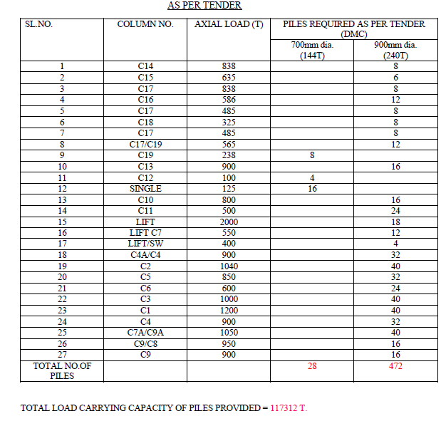
1,17,312 T

Slide 87
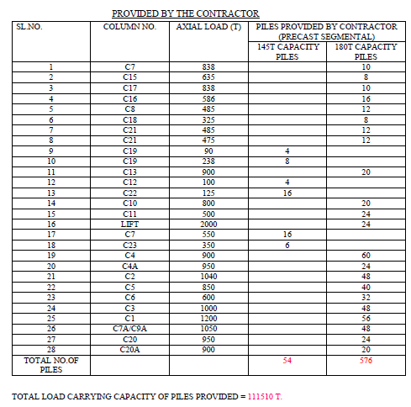
1,11,510 T,
which 5800 T less than the initial tender specified

Slide 88
Total load carrying capacity based on the established allowable capacity for various penetrations
Type | Penetration (m) | No. of Piles | Allowable Load (MT) | Total Load (MT)
PRECAST PILE (Based on Driving Records furnished) | < 35 m | 44 | 42 | 1848
 | 35m - 45m | 431 | 110 | 47410
 | 45m - 55m | 59 | 140 | 8260
 | >55m | 13 | 275 | 3575
Total |  | 547 | I | 61093
No Driving Records available | Assumed 55m | 29 | 180* | 5220
 |  | 54 | 145* | 7830
Grand Total |  | 630 | II | 13050
Grand TOTAL (I+II) |  |  |  | 74143

Slide 89
    Results of group analysis of Column C-15 WITH AND without additional DMC Piles (P4A Group)

Slide 90
Results of group analysis of Column C-15 with additional DMC Piles
Summary of Pile Group – Column C-15 with additional DMC piles
Sl. No | Pile | Size | Penetration (m) | Allowable Capacity (MT)
1 | P-502 | 400mm square | 43.85 | 110
2 | P-503 | 400mm square | 42 | 110
3 | P-504 | 400mm square | 44 | 110
4 | P-505 | 400mm square | 44 | 110
5 | P-1 | 900mm dia | 55 | 240
6 | P-2 | 900mm dia | 55 | 240
Pile Group of Column C-15 with additional DMC piles

Slide 91
Results of group analysis of Column C-15 without additional DMC Piles
Case A : Unfactored Load of 6350 kN
Pile top displacement |  |  |  |  | Pile Top Reaction
Pile no | X (mm) | Y (mm) | Z (mm) |  | Pile no | Pu (kN) | Vu (kN) | Mu (kN-m)
1 | 11.02 | 0 | 0 |  | 1 | 1588.2 | 0 | 0.35
2 | 11.03 | 0 | 0 |  | 2 | 1586.1 | 0 | 0.35
3 | 11.01 | 0 | 0 |  | 3 | 1587.4 | 0 | 0.35
4 | 11.02 | 0 | 0 |  | 4 | 1588.3 | 0 | 0.35
Case B : Factored Load of 9525 kN
Pile top displacement |  |  |  |  | Pile Top Reaction
Pile no | X (mm) | Y (mm) | Z (mm) |  | Pile no | Pu (kN) | Vu (kN) | Mu (kN-m)
1 | BEARING FAILURE |  |  |  | 1 | BEARING FAILURE
2 |  |  |  |  | 2
3 |  |  |  |  | 3
4 |  |  |  |  | 4

Slide 92
With Nominal Lateral Load (40MT) without DMC Piles
Case A : Unfactored Load of 6350 kN
Pile top displacement |  |  |  |  | Pile top Reaction
Pile no | X (mm) | Y (mm) | Z (mm) |  | Pile no | Pu (kN) | Vu (kN) | Mu (kN-m)
1 | 10.19 | 12.78 | -0.18 |  | 1 | 1497.4 | 31.93 | 69.01
2 | 12.05 | 12.78 | -0.18 |  | 2 | 1675.6 | 31.59 | 69.05
3 | 10.09 | 12.79 | -0.18 |  | 3 | 1487.2 | 31.96 | 69.06
4 | 11.95 | 12.79 | -0.18 |  | 4 | 1689.9 | 31.51 | 69.07
Case B : Factored Load of 9525 kN
Pile top displacement |  |  |  |  | Pile top Reaction
Pile no | X (mm) | Y (mm) | Z (mm) |  | Pile no | Pu (kN) | Vu (kN) | Mu (kN-m)
1 | BEARING FAILURE |  |  |  | 1 | BEARING FAILURE
2 |  |  |  |  | 2
3 |  |  |  |  | 3
4 |  |  |  |  | 4

Slide 93
Without Lateral Load with Additional DMC Pile
Case A : Unfactored Load of 6350 kN
Pile top Displacement |  |  |  |  | Pile top Reaction
Pile no | X (mm) | Y (mm) | Z (mm) |  | Pile no | Pu (kN) | Vu (kN) | Mu (kN-m)
1 | 3.81 | 0 | 0 |  | 1 | 731.23 | 0.01 | 0.01
2 | 3.81 | 0 | 0 |  | 2 | 730.94 | 0.01 | 0.01
3 | 3.81 | 0 | 0 |  | 3 | 731.45 | 0.01 | 0.01
4 | 3.81 | 0 | 0 |  | 4 | 731.48 | 0.01 | 0.01
5 | 3.81 | 0 | 0 |  | 5 | 1712 | 0 | 0.11
6 | 3.81 | 0 | 0 |  | 6 | 1711.9 | 0 | 0.11
Case B : Factored Load of 9525 kN
Pile top displacement |  |  |  |  | Pile Top Reaction
Pile no | X (mm) | Y (mm) | Z (mm) |  | Pile no | Pu (kN) | Vu (kN) | Mu (kN-m)
1 | 6.33 | 0.02 | -0.01 |  | 1 | 1075 | 0.4 | 0.29
2 | 6.36 | 0.02 | -0.01 |  | 2 | 1052.6 | 0.41 | 0.29
3 | 6.32 | 0.02 | -0.01 |  | 3 | 1076.2 | 0.4 | 0.29
4 | 6.35 | 0.02 | -0.01 |  | 4 | 1079.2 | 0.4 | 0.29
5 | 6.35 | 0.02 | -0.01 |  | 4 | 2624.7 | 0.8 | 6.78
6 | 6.33 | 0.02 | -0.01 |  | 6 | 2617.3 | 0.8 | 6.78

Slide 94
With nominal lateral load (40MT) with Additional DMC Pile
Case A : Unfactored Load of 6350 kN
Pile top Displacement |  |  |  |  | Pile top Reaction
Pile no | X (mm) | Y (mm) | Z (mm) |  | Pile no | Pu (kN) | Vu (kN) | Mu (kN-m)
1 | 3.42 | 3.26 | 0.02 |  | 1 | 626.51 | 23.27 | 39.91
2 | 4.19 | 3.26 | -0.02 |  | 2 | 839.61 | 22.69 | 39.16
3 | 3.42 | 3.3 | 0.02 |  | 3 | 627.44 | 22.8 | 38.65
4 | 4.19 | 3.3 | -0.02 |  | 4 | 834.53 | 22.55 | 38.76
5 | 3.8 | 3.21 | 0 |  | 5 | 1709.8 | 49.54 | 73.83
6 | 3.81 | 3.35 | 0 |  | 6 | 1711.1 | 49.65 | 74.34
Case B : Factored Load of 9525 kN
Pile top displacement |  |  |  |  | Pile Top Reaction
Pile no | X (mm) | Y (mm) | Z (mm) |  | Pile no | Pu (kN) | Vu (kN) | Mu (kN-m)
1 | 5.85 | 3.86 | -0.02 |  | 1 | 1022.7 | 15.79 | 22.99
2 | 6.83 | 3.86 | -0.02 |  | 2 | 1106.7 | 15.75 | 23.12
3 | 5.85 | 3.86 | -0.02 |  | 3 | 1024 | 15.81 | 23.05
4 | 6.82 | 3.86 | -0.02 |  | 4 | 1130.8 | 15.75 | 23.13
5 | 6.35 | 3.86 | -0.02 |  | 4 | 2624.1 | 31.95 | 23.06
6 | 6.33 | 3.86 | -0.02 |  | 6 | 2616.6 | 31.95 | 23.04

Slide 95
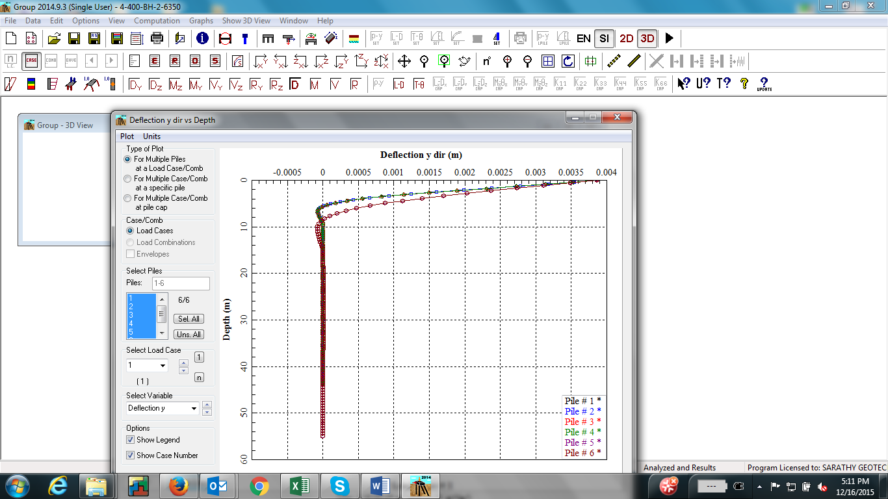
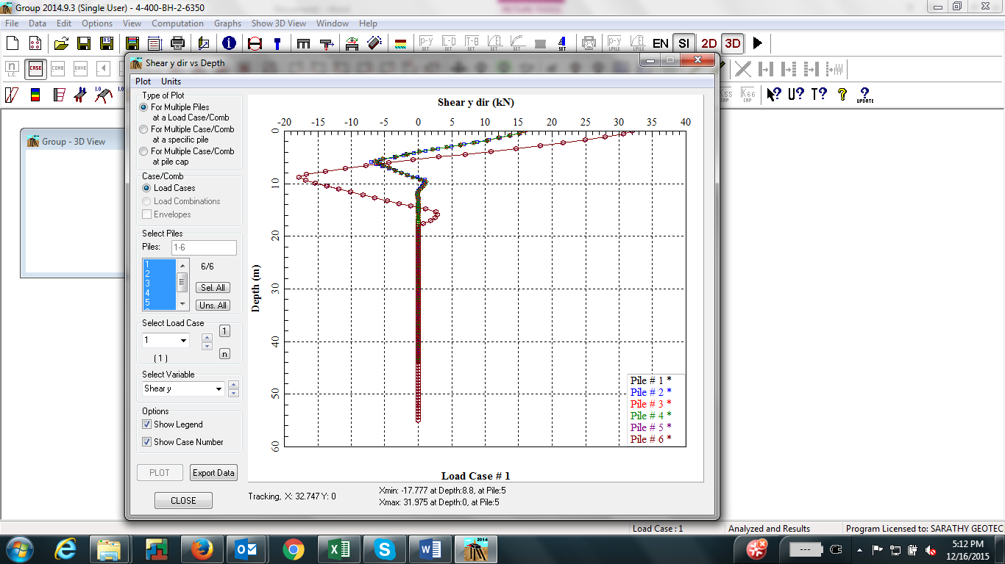
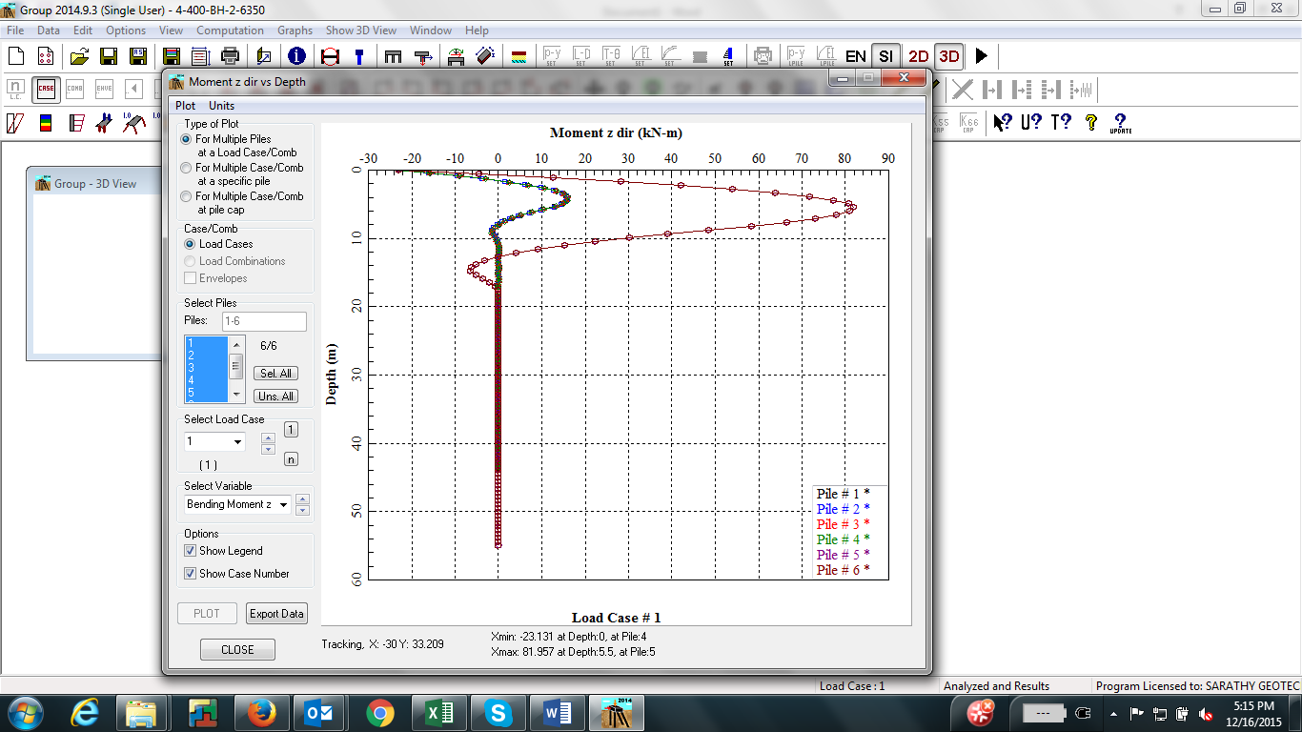
Response of group analysis of pile group (Column C-15) with additional DMC piles

Slide 96
Total load carrying capacity with additional DMC Piles
TYPE | PENETRATION (m) | NO.OF PILES |  | ALLOWABLE LOAD (MT) |  | TOTAL LOAD (MT)
PRECAST PILE (Based on Driving Records furnished) | < 35 m | 44 |  | 42 |  | 1848
 | 35m - 45m | 431 |  | 110 |  | 47410
 | 45m - 55m | 59 |  | 140 |  | 8260
 | >55m | 13 |  | 275 |  | 3575
Total |  | 547 |  |  |  | 61093
DMC PILES | 55m | 282 |  | 240 |  | 67680
Grand Total |  |  |  |  |  | 128773
128773MT>117312MT, Therefore OK
No Driving Records available | Assumed 55m |  | 29 |  | 180* | 5220
 |  |  | 54 |  | 145* | 7830
*Since Driving Records are not available, not sure if these piles were also installed.

Slide 97
PLAXIS ANALYSIS

Slide 98
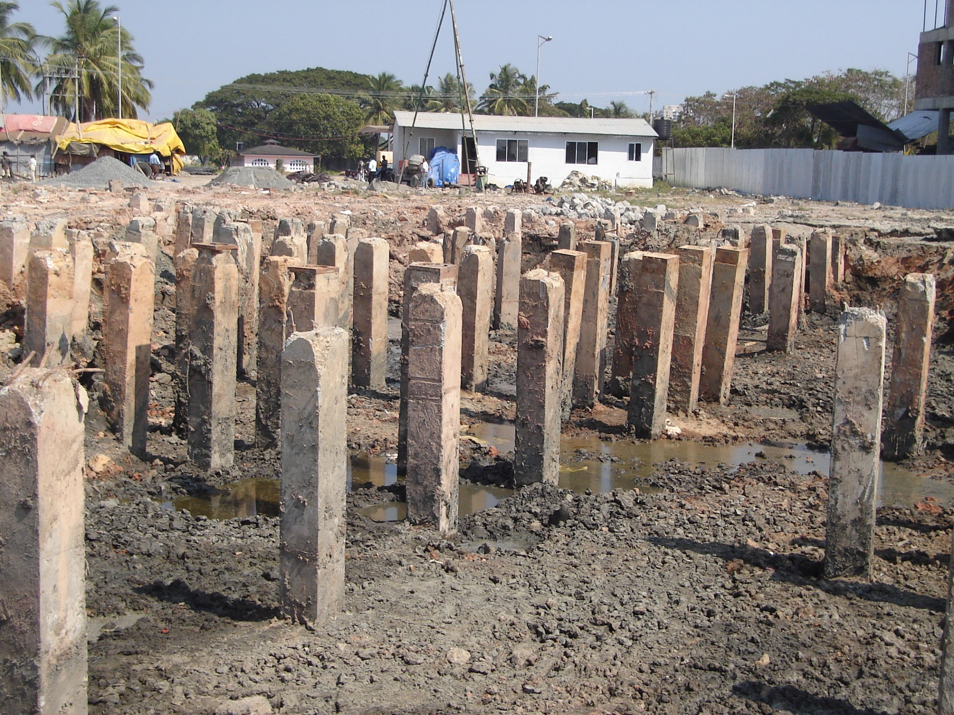

Slide 99


Slide 100
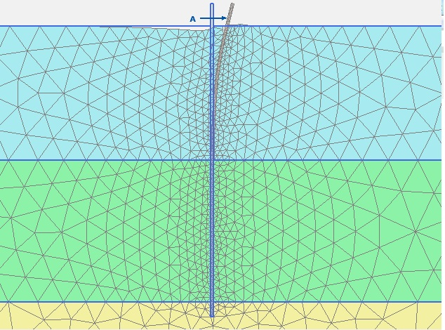

Monolithic Pile
Pile with 11.0m Joint
Horizontal Deformation=137.9mm
Horizontal Deformation=141.9mm

Slide 101


Pile with 11.0m joint- broken
11.0m length pile
Horizontal Deformation=249.0mm
Horizontal Deformation=503.9mm

Slide 102


6.0m length pile
Horizontal Deformation=1617 mm

Slide 103

As per IS 456:2000 , Table 20,
The maximum shear stress for M35 concrete is 3.7 N/${mm}^{2}$. Therefore, the maximum shear force can be calculated as:
P = 3.7 N/${mm}^{2}$ $×$ Gross area
= 3.7 $×$ 400 $×$400
= 59.2 MT.
For the pile to shear, it requires a force of about 59 MT, which force a mere soil movement cannot produce neither by inadvertent push of JCB.

Slide 104
SUMMARY AND CONCLUSIONS
AXIAL PILE CAPACITY
The tender specified (proposed by CLIENT), allowable axial pile capacity of 240MT of 900mm diameter and 55m long pile is in order.
The precast piles shallower than 55m do not meet the requisite allowable pile capacity of 180MT or the requisite factor of safety of 2.5 for single pile by static methods, let alone other structural requirement

Slide 105
SUMMARY AND CONCLUSIONS
PRE-INSTALLATION DRIVEABILITY STUDY
It is established the efficiency driving system was less than 50%, which is in line with the information reported in the literature for type of driving system adopted in the High Rise Project
2. It is also established that the ultimate capacity estimated by dynamic formula do not meet the requisite factor of safety for nearly 80% of piles installed.

Slide 106
SUMMARY AND CONCLUSIONS
PILE GROUP ANALYSIS
Pile group analysis indicated bearing failure for piles shallower than 45m.
It was inevitable to carry out remedial measures by installing additional DMC piles (900mm dia, 55m long), without which the safety of foundation would have been jeopardized.
After installation of additional DMC piles (900mm dia, 55m long), the total required capacities are achieved ensuring the safety of foundation.
LATERAL DISPLACEMENT OF PILES
Finite element Plaxis analysis suggests that for any lateral movement of piles more than 500mm, there is possible shear of piles (due to over stressing during driving or splice damage).

Slide 107
SUMMARY AND CONCLUSIONS
FINAL CONCLUSION
Lastly, the design and build of segmental precast driven piles proposed by CONTRACTOR did not meet the CLIENT’s requirement in terms of pile capacity, length and safety.
Since SGES and its representatives were not involved at any stage and at any capacity for this project, the conclusions drawn based on only on the review of the materials/information provided.

Slide 108
Indian Geotechnical Society
http://www.igs.org.in
Select | 12418 | 2041 | Dr. C.R. PARTHASARATHY | partha@ sarathygeotech.com | BANGALORE
partha@sarathygeotech.com

Slide 109

http://igc2018.com/

Slide 110
THANK YOU
QUESTIONS?

